Slide 1

Text Processing For NLP Word Count
Discover the power of word count and how it can aid you in language analysis. Explore common challenges and discover how to preprocess text for accurate results.

Slide 2



Introduction to Word Count
Counting Words
Text Analysis
Applications
Learn about word count and how it can be a useful tool for analyzing language.
Understand how word count is a starting point for many text analysis tasks.
Explore how word count can be used in a variety of areas like sentiment analysis, stylometry, and content analysis.

Slide 3
Significance of Word Count
Insightful 🧐
Efficient 💪
Cost-Effective 💰
Word count is a primary indicator of the size and complexity of a piece of text.
It's a quick and easy way to gain insight into the linguistic features and patterns of a text.
It's an inexpensive way to gain important insights about the language used in various industries and settings.

Slide 4
Basic Word Count Methodology
Step 2: Counting
Count the number of occurrences of each unique word.
1
2
3
Step 1: Tokenization
Step 3: Analyzing
Split the text into individual words or tokens.
Analyze the frequency distribution of words in the text.

Slide 5



Tokenization for Word Count
Sentence Tokenization
Word Tokenization
Understand how to break text into sentences before counting words.
Learn how to break text into individual words before counting them.
Cleaning Text
Discover how cleaning text can improve word count accuracy.

Slide 6

Case Sensitivity in Word Count
1
Important 🔍
2
Solution 🔧
Words with different capitalization can have different meanings and implications.
Set all words to lowercase before counting.
3
Exception 🤔
When case is important for analysis, use mixed-case counts.

Slide 7



Common Word Count Challenges
Accuracy
Balancing Act
Discuss common challenges like idiomatic expressions, slang, and ambiguity that can impact word count accuracy.
Identify the trade-offs between precision (low false positives) and recall (low false negatives) in word count.
Scaling Up
Explore scalability issues and solutions when counting words in large datasets.

Slide 8
Word Count for Language Analysis
Comparative Analysis 👥
Tracking Language Changes 📅
Brand Positioning 🏢
Use word count to analyze the language used by your competitors to identify your own strengths and differentiate yourself from others.
Use word count to compare language patterns between different groups of people, like men and women or liberals and conservatives.
Use word count to analyze changes in language use over time and see how language is evolving.

Slide 9
Word Frequency Distribution
1
Zipf's Law
Understand how word count distributions follow a long-tail pattern.
Common Words
2
Recognize that the most frequent words in a language are function words like "the", "of", and "and".
3
Unknown Words
Expect that a large percentage (20-30%) of words in a given text may be unknown or infrequent based on corpus analysis.

Slide 10
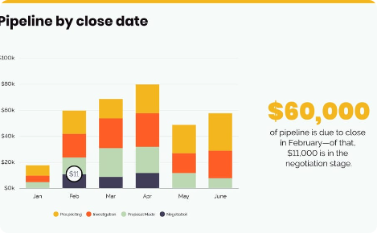
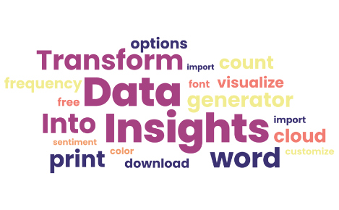
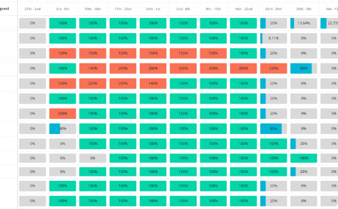
Visualization of Word Frequency
Bar Chart
Word Clouds
Create bar charts to visualize the frequency distribution of words in a text.
Create word clouds to visualize the most frequent words in a text as a graphic image.
Heat Maps
Use heat maps to visualize the frequency and relationship between different words in a text corpus.

Slide 11
Applications of Word Count
1
Sentiment Analysis
Identify the emotions and opinions expressed in a text by counting the frequency of positive and negative words.
Stylometry
2
Comparison of writing styles, authors and similarity measurement, plagiarism, deception detection, forensic analysis.
3
Content Analysis
Use word count for content analysis of books, online reviews, social media data, and more.

Slide 12
Challenges in Word Count
Irregularities 🐛
Language Complexity 🔍
Data Set Selection 📈
Idiosyncrasies, contradiction, ambiguity, and idiomatic expressions can pose challenges for accurate analysis of word count.
Choosing the right data set to evaluate or train a language model can be challenging when considering scalability, corpus diversity, and complexity.
Counting words in languages with distinct writing systems, such as Chinese or Japanese, raises new challenges for text processing.

Slide 13
Preprocessing for Accurate Word Count
1
Cleaning Text
Remove ambiguous characters and symbols, and fix common transliteration errors.
Normalization
2
Normalize text by removing punctuation, replacing numbers with words, and removing common function words.
3
Stop Words Removal
Remove commonly used words like "the", "of", "a" etc, which do not provide much value in understanding the text.

Slide 14


Limitations and Future Directions
Limitations
Future Directions
Discuss the limitations of word count and its applications in natural language processing.
Explore promising areas of research, such as deep learning models and hybrid language analysis techniques.

Slide 15

Conclusion
1
Summary 📝
2
Implications 🤔
Recap the main themes and concepts introduced throughout the presentation.
Discuss the implications of word count on the field of natural language processing and its many applications.
3
Looking Ahead 🔍
Explore exciting developments in the field and preview future research directions.

